Slide 1

Matchability (part 1)
June 21st, 2019
Notes:
Good afternoon everyone, thank you for having us!
So its been around 2 weeks since we last met.
Ending our last meeting, we had defined what the main objectives for today were and what we were going to be working on up till now, which overall regarded exploring the AISEC database, understanding how the first steps of the matchability algorithm would work and how we would go about getting setup for further iterations.
So let’s dive into it right now.

Slide 2
Overview
Data Cleaning
On average, 0.03% of date fields on each columns were badly formatted.
Frequent use of mixed null data types: floats, numpy.nan, strings, etc.
Other.
Data Manipulations
Merging of opportunities and applications in preparation for model training.
Computing the opportunity acceptance rate per country and visualizing it.
Data Analysis
Interpreting the acceptance rate world map.
Descriptive analysis of the data based on acceptance rate per region and country.
Relating correlated proxy variables (HDI, GDP per capita)
Notes:
So the plan is the following: we’ll briefly skim over the main data cleaning procedures that were necessary to start analyzing the data before jumping into the core manipulations that were carried out and then finally look at the descriptive analysis of the results produced.
So quickly hitting those bullet points, in terms of cleaning we tackled the following… (on slide)
For the manipulations, (on slide)
And lastly, but most importantly, (on slide)

Slide 3
Data Cleaning
What was cleaned, why?
Data Cleaning
Openings
Dates
NaN types
Threshold handling opportunities with absurd amounts of openings.
Mainly coming from: Egypt, Brazil, Iran and some others.
Mainly years value in date fields found to be inconsistently written.
Affected ability to select rows properly by their datetimes.
Null/NaN types found to have variable types in the table.
Error checking, null evaluations and value replacements made more difficult.
Notes:
Very briefly, the data cleaning was focused on three main aspects: filtering absurd opening numbers, formatting date fields, and evaluating inconsistent null types in the database.
Overall, these were standard procedures so won’t spend too much time on this… Although it would be nice if your web developers took a little more time and energy to validate and format the data inputs ;)

Slide 4
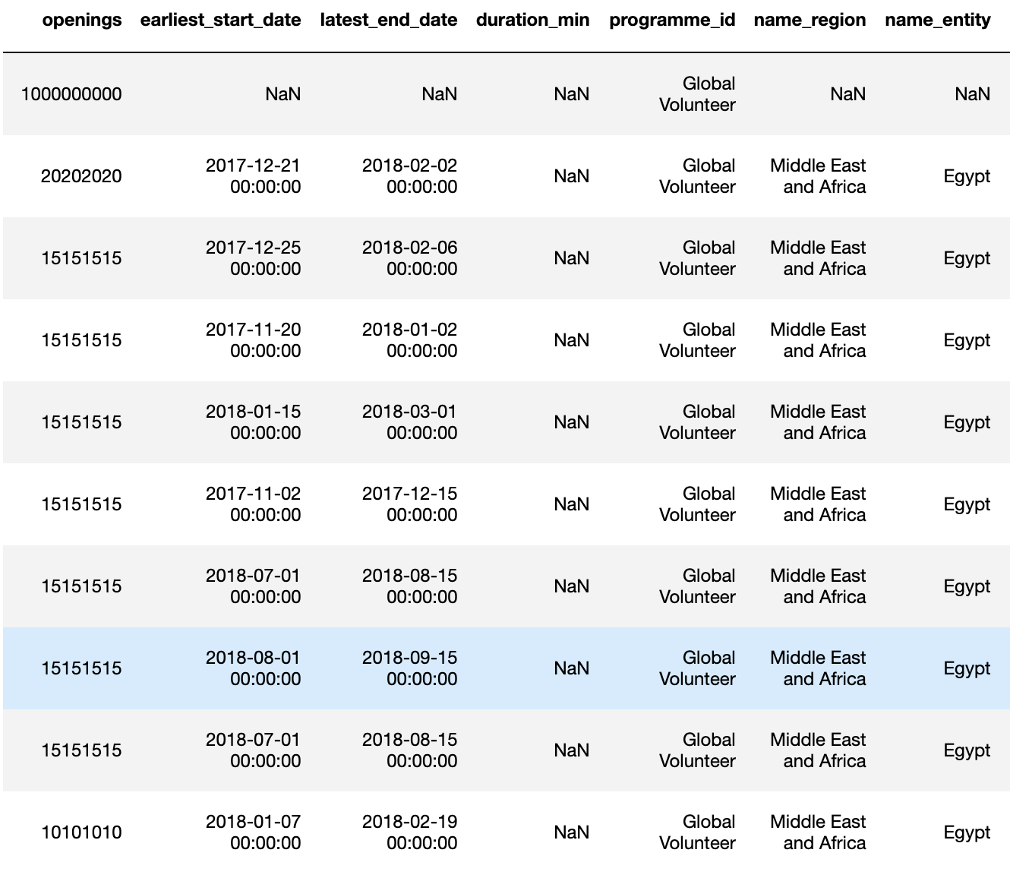
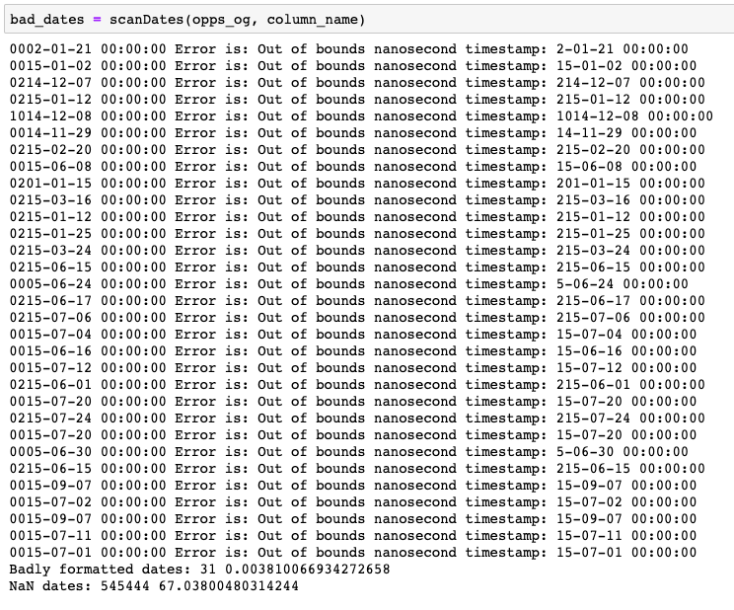

Data Cleaning (contd.)
What was cleaned, why?
Notes:
So just to top off this discussion about data cleaning, which is far too captivating ;) … here are some examples of cleaning required for the number of openings and for the date formats...
Any questions?

Slide 5
Data Manipulation
What operations were done on the data?
Opportunities
Merged
Applications
Data Manipulations
Newly created variables of interest:
application_open_window, experience_max_duration, created_vs_earliest_start, created_vs_latest_end, experience_timeframe_rigidness, hot_days_intersection, popular_time_period_factor
Notes:
Alright so moving down to the core data manipulations. The idea, as part of the main objective for today’s meeting regarding the exploration and descriptive analysis of the database in preparation for the matchability algorithm, was to merge the opportunities and the applications tables into one and to extrapolate additional variables which would be of strong interest.
In other words, for each opportunity, we stored the number of accepted applicants, the basic opportunity description and derived other variables which I’ll present to you in just a second.
This merge was very useful to represent the acceptance rate of experiences around the world relative to the region. We’ll come back to this shortly.

Slide 6
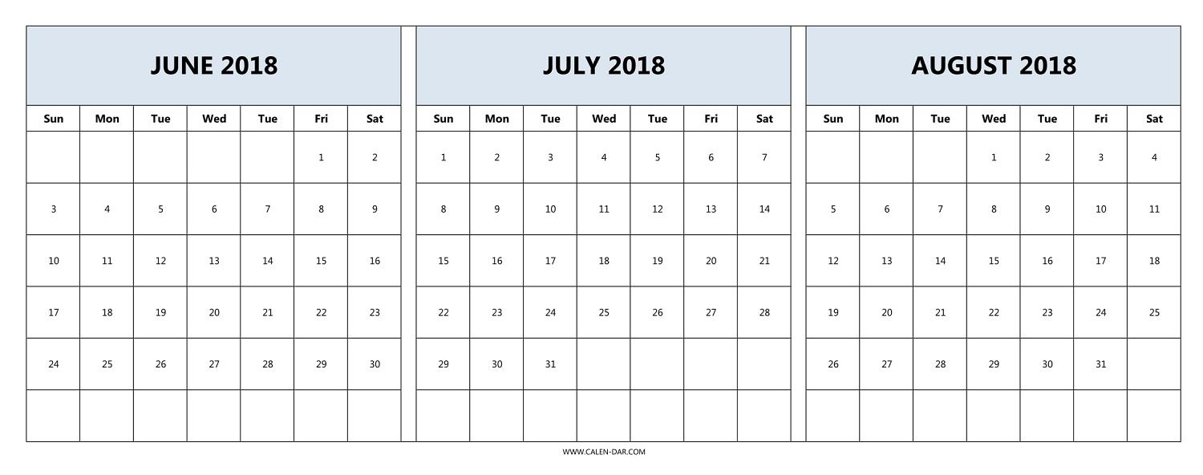
Data Manipulation
New variables of interest.
created_vs_earliest_start
experience_max_duration
created_at
application_close_date
earliest_start_date
experience_start_date
experience_end_date
latest_end_date
duration_min
created_vs_latest_end
application_open_window
experience_max_duration
experience_timeframe_rigidness
=
duration_min
hot_days_intersection
Notes:
So visually here we interpret the meaning of the newly created variables.
Two interesting new variables, although mathematically relatively simple to obtain, are the experience_timeframe_rigidness and the hot_days_intersection.
The first describes how restricted the timeframe of the experience is, by comparing what the ratio between the maximum duration and the actual duration. For example, an internship starting on the 1st of June and ending on the 30th of June having a duration of 4 weeks is far more ”rigid” than one lasting 1 week for the same timeframe. This will come in handy later on.
Then, the hot_days_intersection basically assumes, with strong confidence that the months of July and August are very popular periods which students target giving these periods importance. Therefore, we simply calculate the number of days of an experience that intersect this period to rank the expected popularity of a similar experiences with different start and end dates.

Slide 7
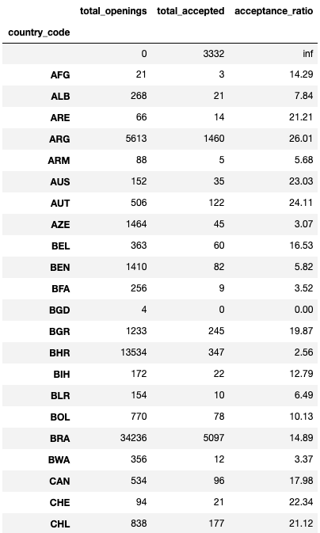
Data Manipulation (contd.)
What was done with the data?
Merged
…
Notes:
Finally, by combining the merged table and the newly created variables, we come up with an acceptance rate based on the country emitting the opportunity.
As this is pretty self-explanatory, we’ll jump to the visual representation of these results on a nice world map right away.
Any questions?

Slide 8
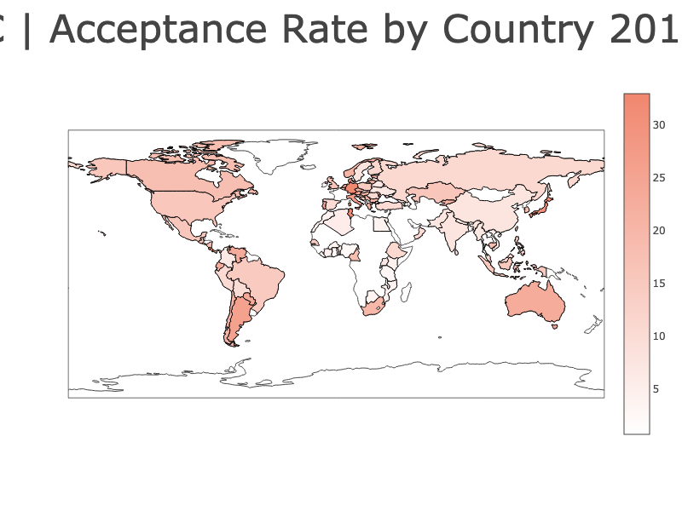

Data Analysis
How did we analyze the “attractivity” of an opportunity?
Acceptance Rate by Country | 2014 - 2018
external link
Notes:
Now, here’s the acceptance rate, for the years 2014 to 2018. (pause)
We can open this locally on the browser also to drag around the map and analyze certain regions more in depth.
Most of the pattern observed are expected and are useful as we will be correlating these geographical acceptance rate patterns with other indicators such as the Human Development Index and the Gross Domestic Product.

Slide 9
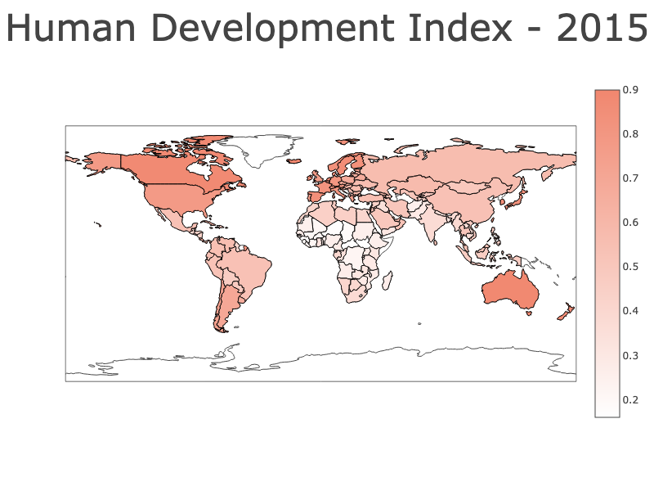
Data Analysis (contd.)
How is the HDI correlated to the acceptance rate of an opportunity?
Human Development Index (including GDP metric factor) | 2015
https://ourworldindata.org/human-development-index#historical-index-of-human-development-hihd-and-gdp
Notes:
So, as mentioned, if we display the Human Development Index including the GDP metric factor from 2015, we observe a strong correlation between the higher acceptance rate regions and the map show here.
In other words, if we put the two maps side-by-side...

Slide 10
Data Analysis (contd)
Comparing the two plots.
Acceptance Rate
HDI
Acceptance rate can be correlated to the HDI (with GDP metric factor).
Notes:
Now, here we clearly see that we can establish a correlation between the acceptance rate of an opportunity in a certain country or region with social and economical indicators such as the Human Development Index and the GDP of a country!
This will form the basis of the model for further steps.
Any questions?

Slide 11
Data Analysis (contd)
Experience description variables to consider.
Experience Description
Level of education
Weekly workload (hours)
Organization type
Language
Start/End date
Number of employees
Salary
Duration (weeks)
Which should we prioritize? What are some other important variables to consider? How to retrieve them?
Notes:
Last point I would like to raise is regarding the different variables listed for an experience/job description.
Here, we listed 7 variables which we though would be appropriate and relevant to study, but we would like your input on this.
Which should we prioritize?
What are some other important variables to consider?
If so, how do should we retrieve them?

Slide 12
Conclusions
Database dates and NaN types problematic, need intensive cleaning.
Cleaning required.
Handling opportunities with absurd openings numbers.
Cleaning required.
Merging of opportunities and applications table.
Preparing data for model training.
Practical and efficient to perform a descriptive analysis of the acceptance rate of an opportunity based on the country emitting it.
Global view of the “attractivity” of opportunities around the world.
Variables to be considered during experience description an analysis.
Notes:
To wrap it up, we looked at these topics today:
(read slide)

Slide 13
Next steps
Consolidate the choice of the variables of interests to be considered in the model.
Experience description variables.
Approve the newly created variables in the “merged” table of opportunities and application.
Question: What is the meaning of the variable close_date? Is it related to the date where an applicant is found?...
Feedback on analysis of acceptance rate with HDI
Reliable correlation. Other proxy variables possible.
Keeping the correlation updated over the years with new HDI data sources.
Notes:
Finally, here’s what we would need to discuss with you today: (read slide)
Thank you for your time!

Slide 14
Matchability (part 2)
July 26, 2019

Slide 15
Overview
Philosophy behind the matchability algorithm
SQL Extraction
Cleaning & Formatting
Manipulations, Features, New Variables
Modelling
Analysis
Next Steps
Appendix & Documentation

Slide 16
Philosophy
Identify the end goal to be to consistently predict whether an opportunity will find a match or not.
To do so we must:
Extract, clean, trim, format, manipulate, and expand the data efficiently.
Identify the features which generate the most reliable and accurate predictions.
Produce a detailed and commented script.
All in one single file: matcha.py

Slide 17
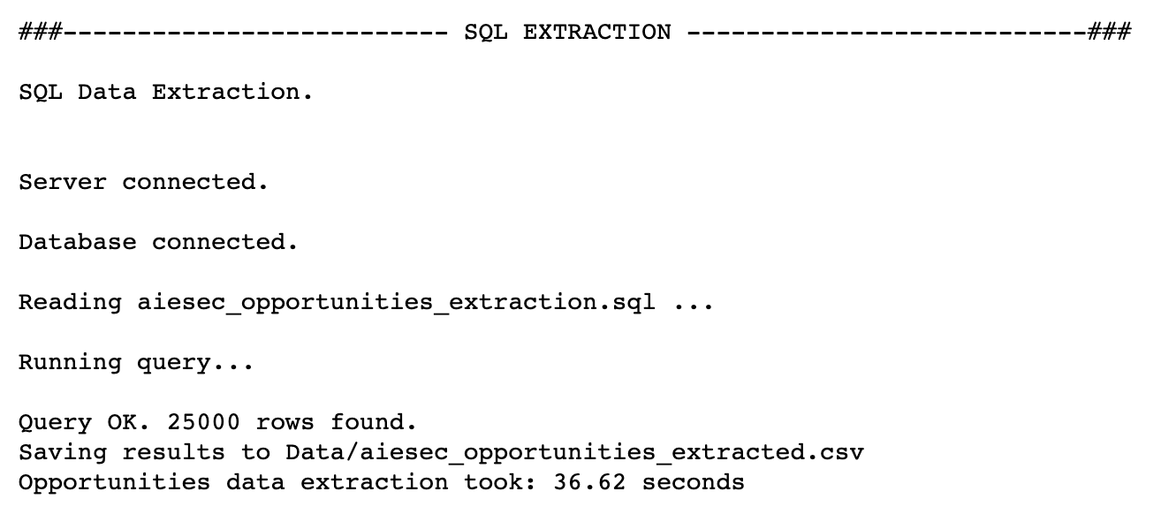
Extracting the features
opportunities
programmes
opportunity_applications
offices
people

Slide 18
Cleaning
Filtering
Openings threshold.
Opportunities with status “open”.
Trimming
Dropping duplicate opportunity_id rows.
Replacing infinite values with NaN.
Formatting
Date formatting for columns: created_at, applications_close_date, earliest_start_date, latest_end_date.
On average, around 12-18% of the originally extracted data is formatted and/or dropped.

Slide 19
Features 1 of 2
New variables as discussed on June 21st.
Title length
Year completion ratio
Description length
Number of languages
Salary
Is food provided
HDI
Programme type
Pro: computing and merging fast and efficient.

Slide 20
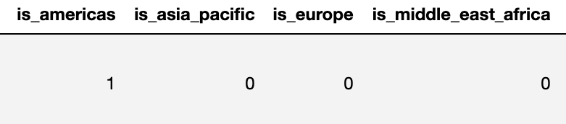
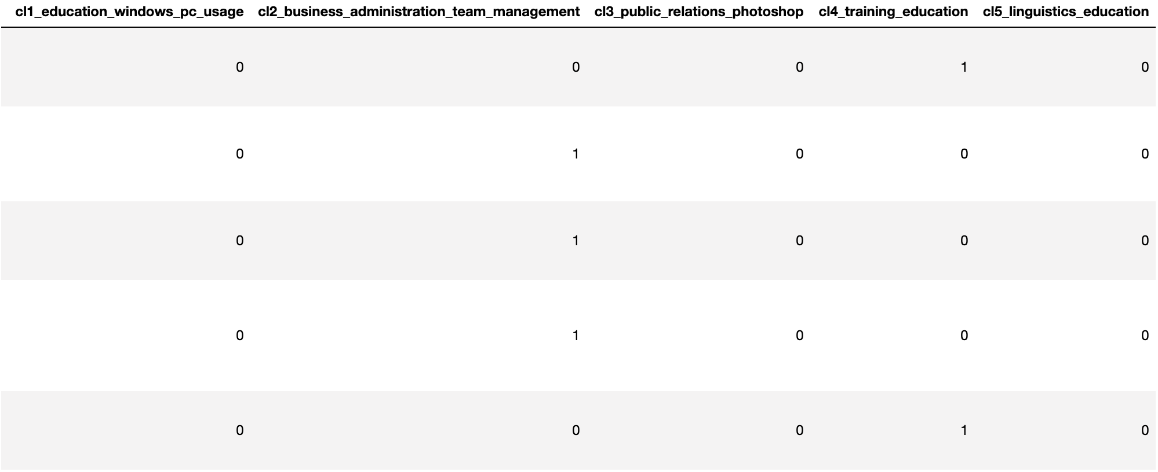
Features 2 of 2
We also add other ”one-hot encoded” variables.
Regions
Job Description
“1” is encoded in the proper column for that opportunity, the rest are zeros.
Merge the columns: opp_skill_req, opp_skill_pref, opp_background_req, opp_background_pref into a skills column
skills
is_americas
is_europe
is_asia_pacific
is_middle_east_africa
Perform a text analysis on the skills column. (K-Means)

Slide 21
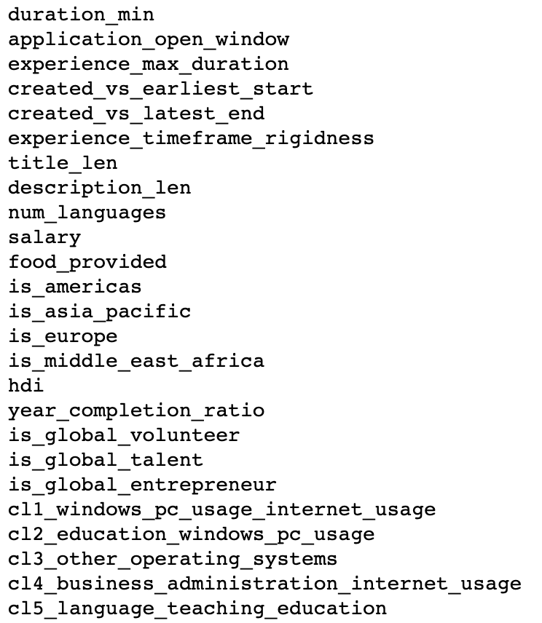
Modelling
Features of interest:
To understand the data, we applied a logistic regression and fitted a decision tree.
Let’s take a look...

Slide 23
: controllable features

Slide 24
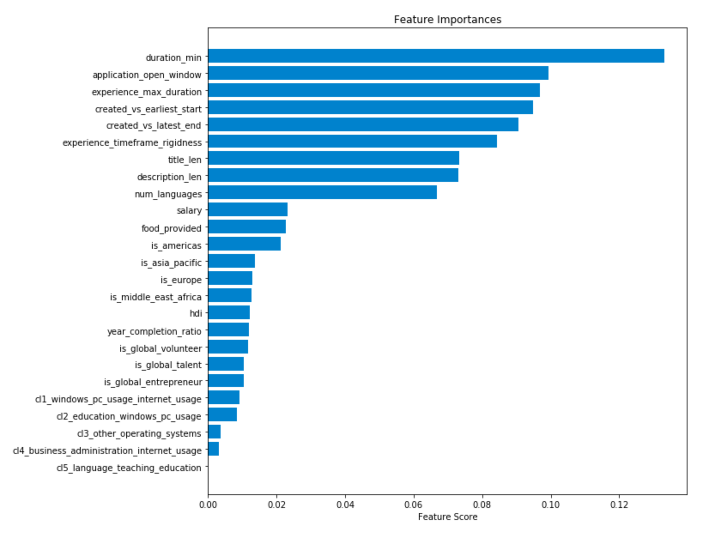
Modelling

Slide 25
Modelling
context
benefits
location
content

Slide 26
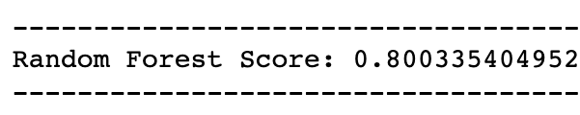
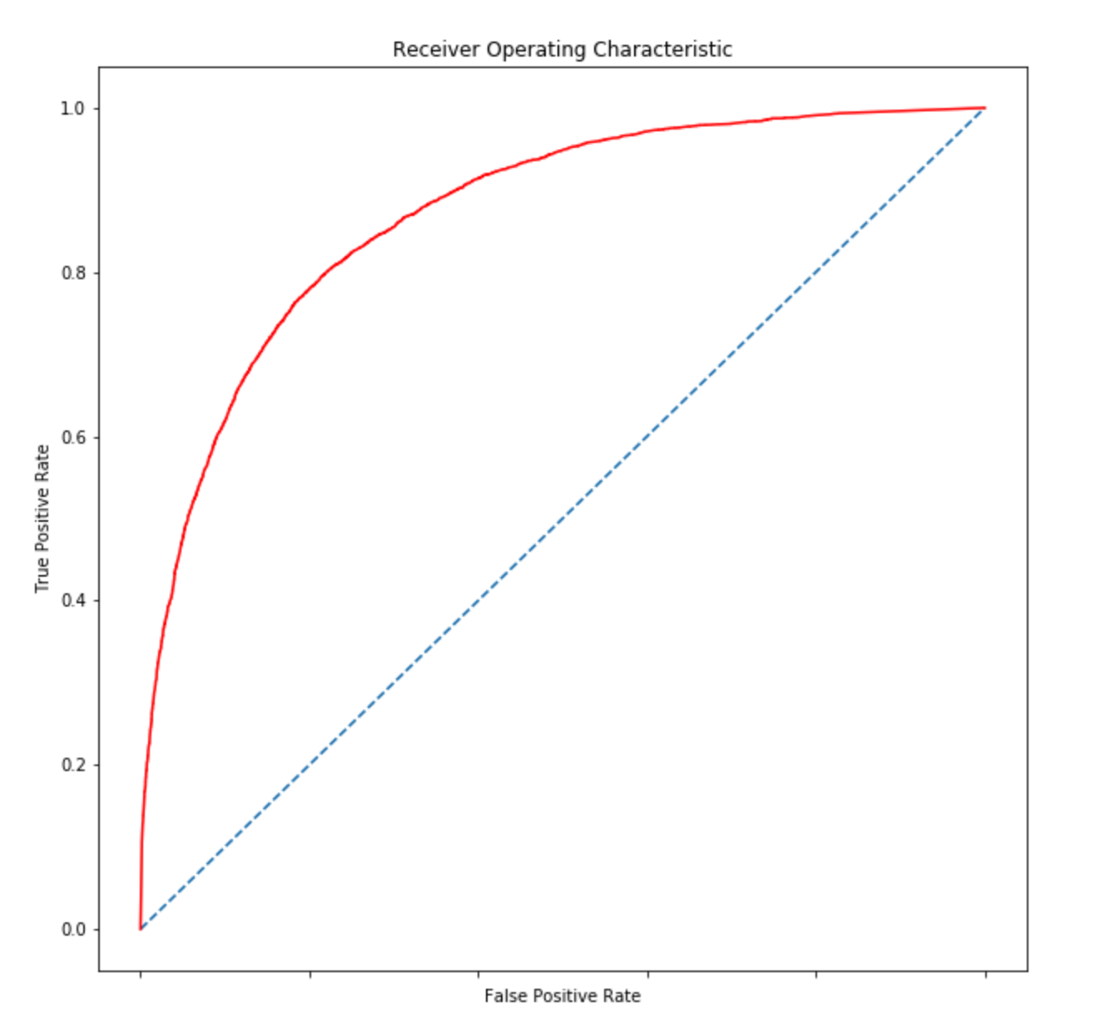
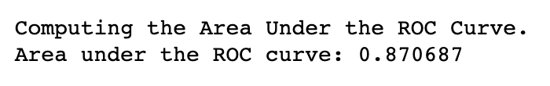
Analysis 1 of 2
Model predicts correctly 80% of the time.
Reliability of the model shown by the ROC curve.
Random Forest Classifier takes 5.5 seconds to be trained given around 70k entries.

Slide 27
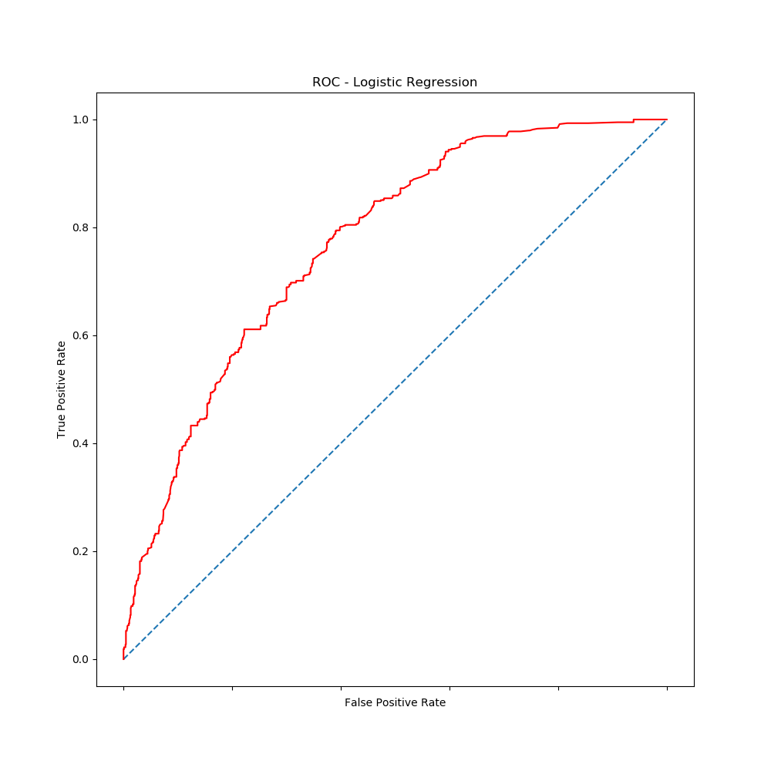
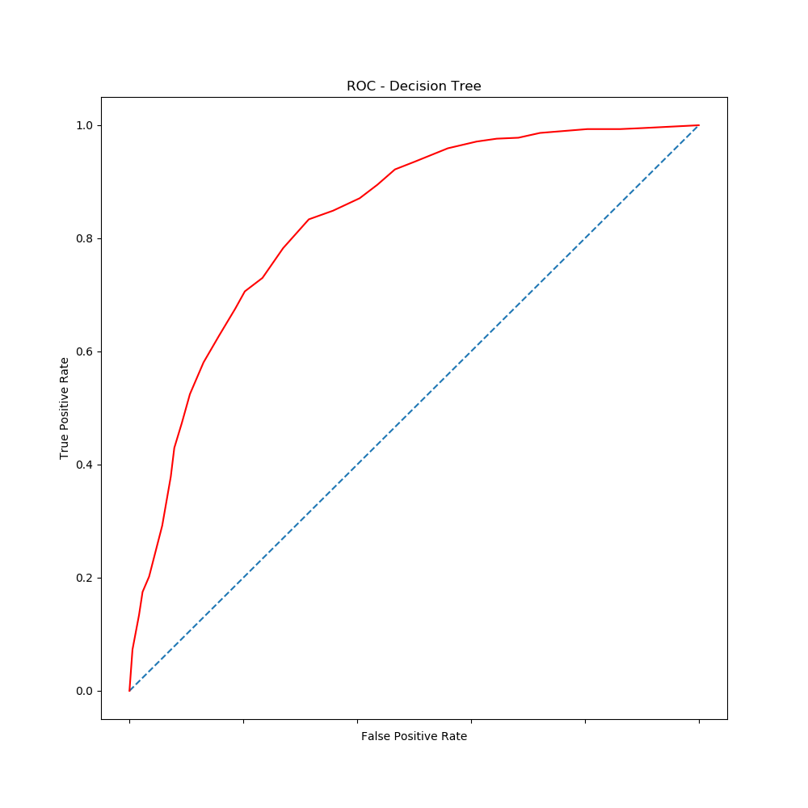
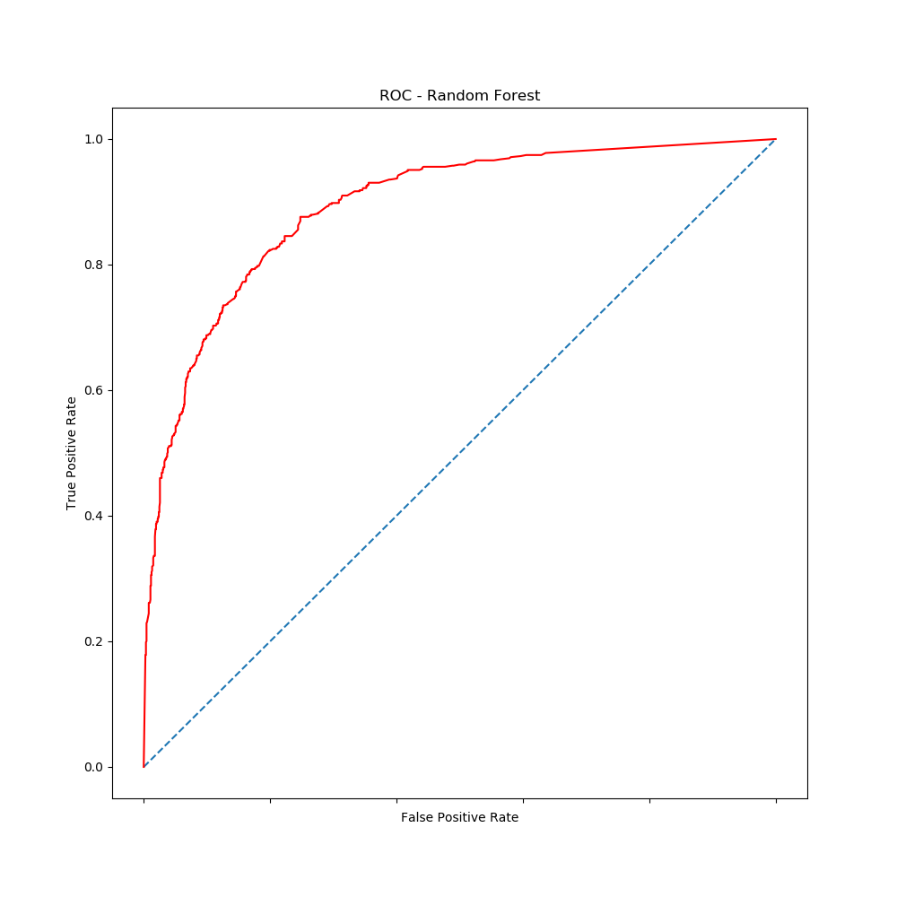
Analysis 2 of 2
Interestingly, this does not appear to be linear problem...

Slide 28
Next Steps
What do we have now?
A reliable model which can predict whether a newly created opportunity will found matches or not.
What to do now?
Need to discuss how the data will be inputted into the model and in which format.
Recommendations from us?
Probably a good idea to retrain the model every month or so as an automated cron job.

Slide 29
Appendix

Slide 30
Appendix
Table of contents
Section Page
Imports .............................................................................................................................. 1
Helper functions ................................................................................................................. 2
SQL Extraction ................................................................................................................... 4
Fetching Data Locally ......................................................................................................... 5
Data Cleaning, Filtering, Trimming ...................................................................................... 6
Data Manipulations
Extracting Variables of Interest ........................................................................ 7
Text Analysis of Job Description ....................................................................... 8
Expanding by Openings ................................................................................... 9
Modelling
Logistical Regression ...................................................................................... 10
Decision Tree Classifier ................................................................................... 11
Random Forest Classifier ................................................................................ 12
Analysis
Classification Rates, ROC curves .................................................................... 13

Slide 31
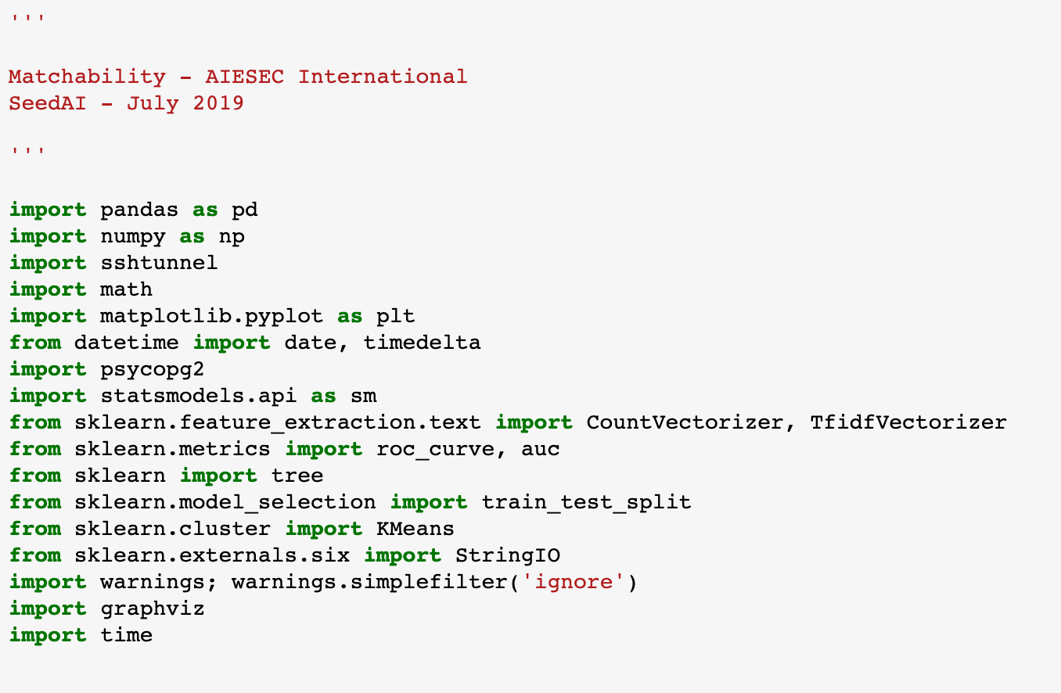
1
Imports
Importing the data analytics essentials: Pandas & Numpy.
SSHTunnel for connecting to the remote AIESEC server using the private key file (.pem file located in the same working directory).
Psycopg2 for connecting to the PostgreSQL Database.
Sklearn: CountVectorizer, TfidfVectorizer, Kmeans → used for the job description text mining.
Sklearn: roc_curve, auc, tree, train_test_split, StringIO → used for decision tree and model analysis.
Statsmodels: using the Logistical Regression method from the library.
Graphviz: used to visualize the decision tree.
Importing the time module to measure code’s efficiency.

Slide 32
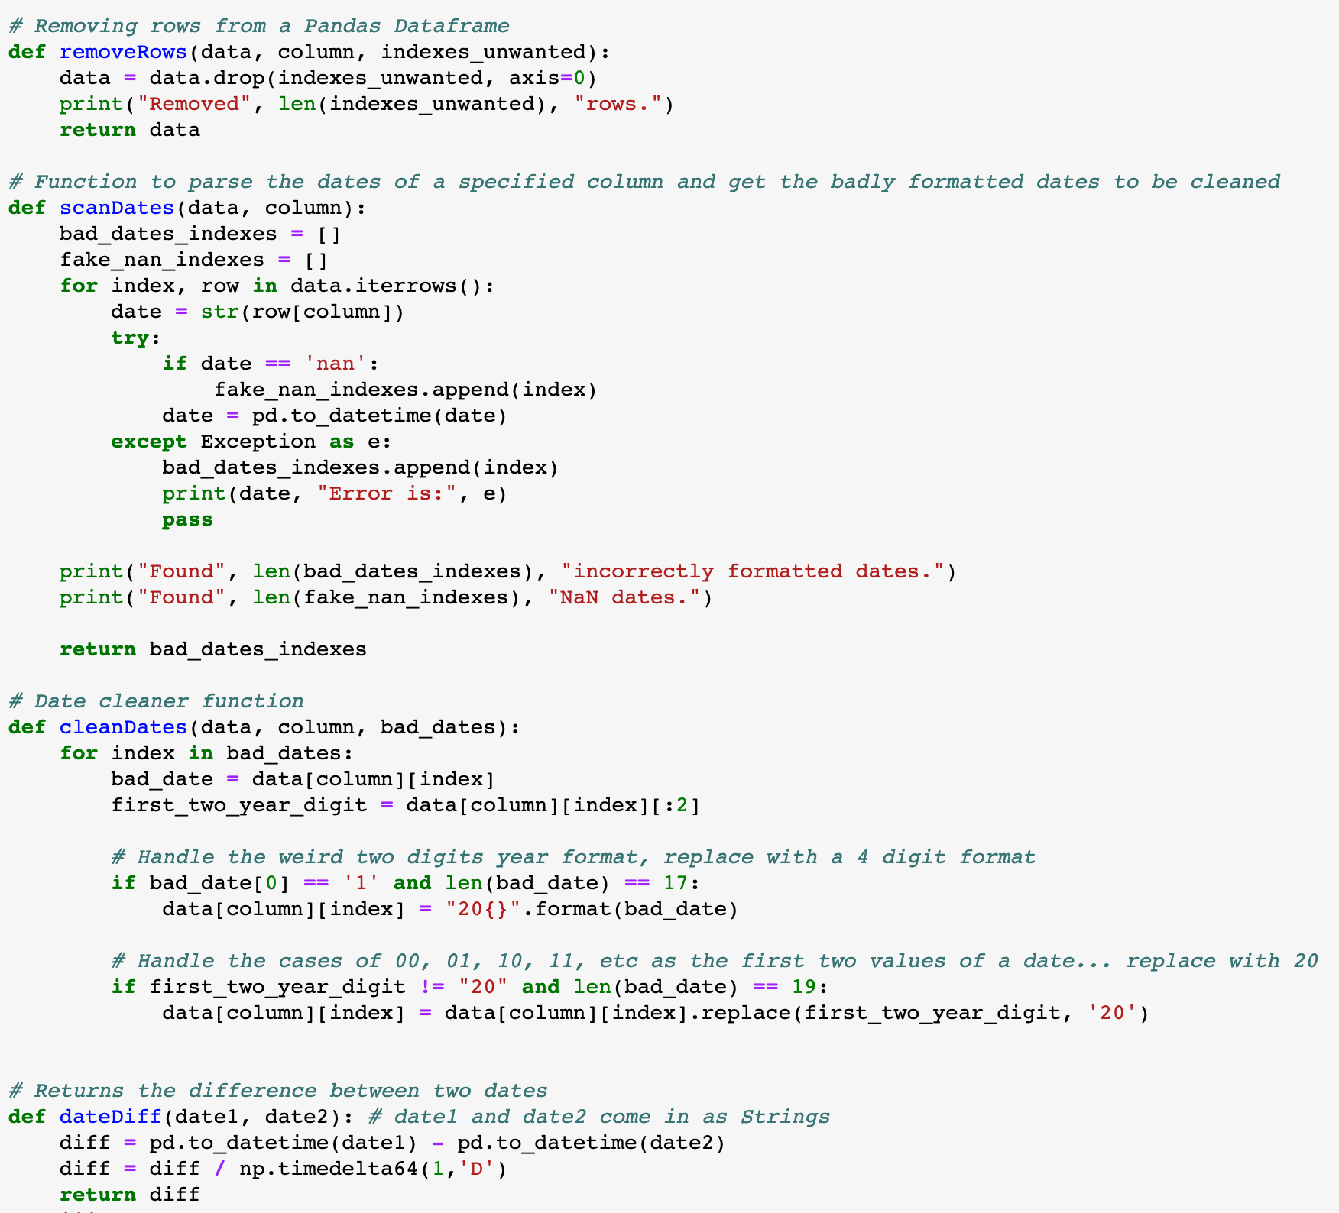
2
Helper Functions (1/2)
removeRows() function used to drop some rows from a Pandas dataframe. Required to pass the dataframe object, the target columns and the list of unwanted indexes.
scanDates() function iterates over a given dataframe object on a specified column and records all date strings which are either “NaN” or that cause an error when being converted to a panda datetime object.
cleanDates() function is called after the scanDates() function and attempts to format the dates picked up by scanDates(). Typical formatting errors include having a two year digit format instead of a 4 digit format or having an incorrect thousands value for the year (i.e.: 1014, instead of 2014)
dateDiff() function simply computes the difference between two Panda datetime objects and returns the result in days.

Slide 33
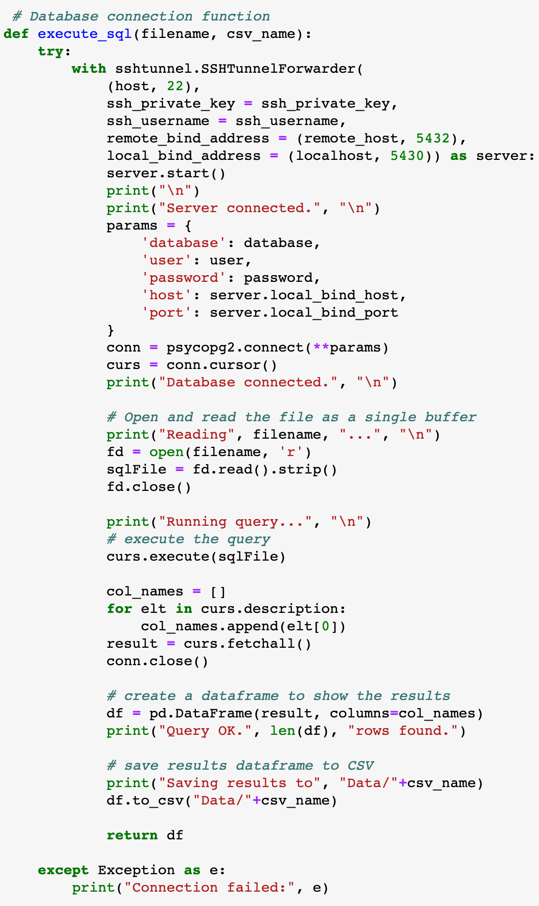
3
Helper Functions (2/2)
execute_sql() function is used to connect to the remote AIESEC server and the and database. The parameter filename refers to the .sql script to execute from the current working directory and the csv_name parameter is the name the will be given to the generated table from the data extraction, also stored in the current working directory.
(See next page for the initialization of the connection variables: ssh_private_key, ssh_username, remote_host, localhost, database, password, etc.)
Connect to server.
Connect to the database.
Open the external .sql extraction script.
Remove whitespaces around the script, just in case.
Execute the script.
Construct a new Pandas dataframe with the query results by iterating over the curs.description results object.
Close the database connection.
Create the dataframe from the results and the column names.

Slide 34
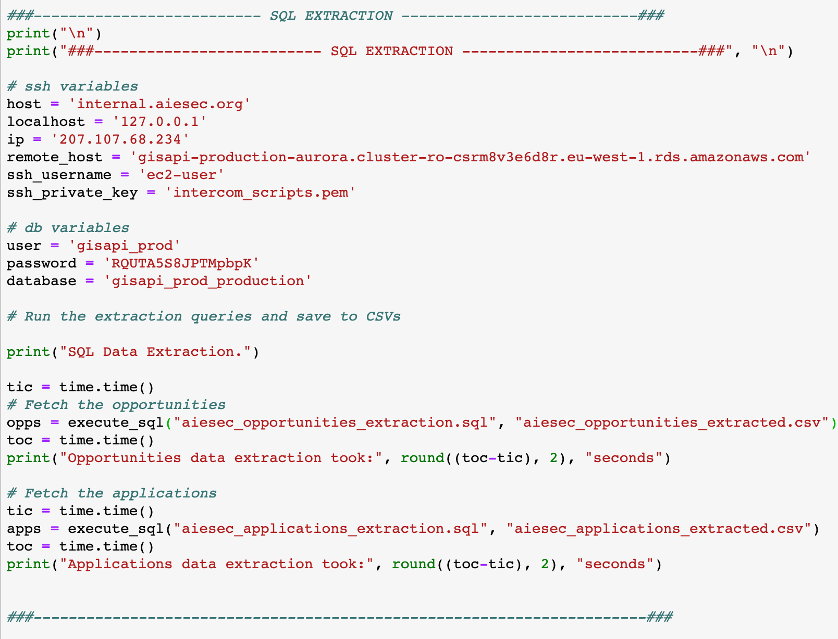
4
SQL Extraction
The connection parameters are listed here.
Make sure the private key (.pem) file is in the same working directory as the main matcha.py file.
We call the execute_sql() function once for the opportunities data extraction, passing it the specified parameters. We measure the execution time.
We do the same for the applications, holding our target variable.
In both these extractions, a CSV file is saved locally.

Slide 35
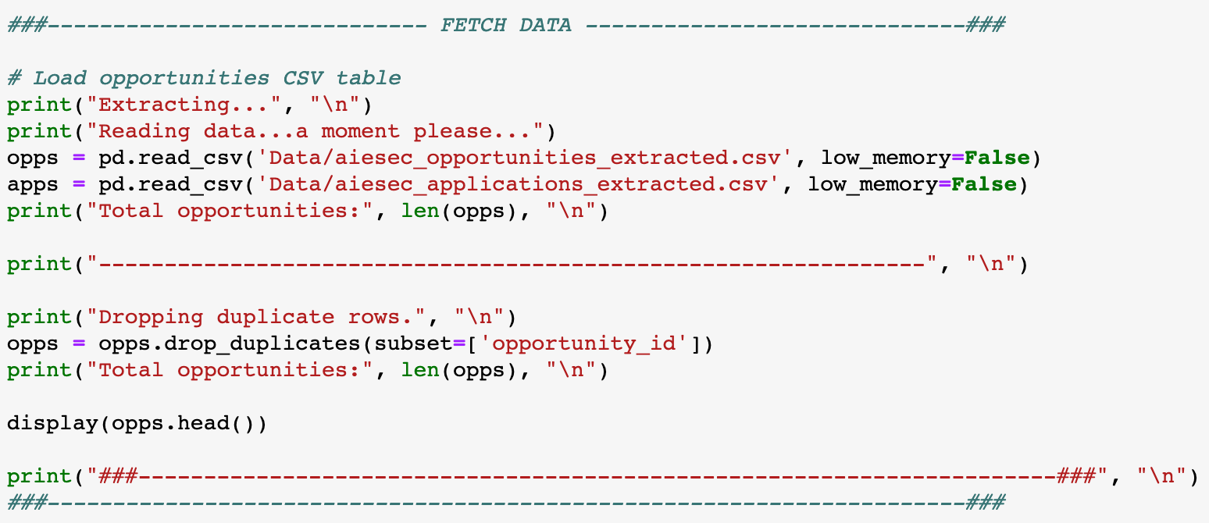
5
Fetching Data Locally
Load the local CSV files using the common Pandas read_csv() function. the low_memory parameter is not deprecated yet nor essential but is still specified.
For more details: https://stackoverflow.com/questions/24251219/pandas-read-csv-low-memory-and-dtype-options
Remove duplicates rows from the opportunities dataframe (opportunity_id columns as the unique identifier).

Slide 36
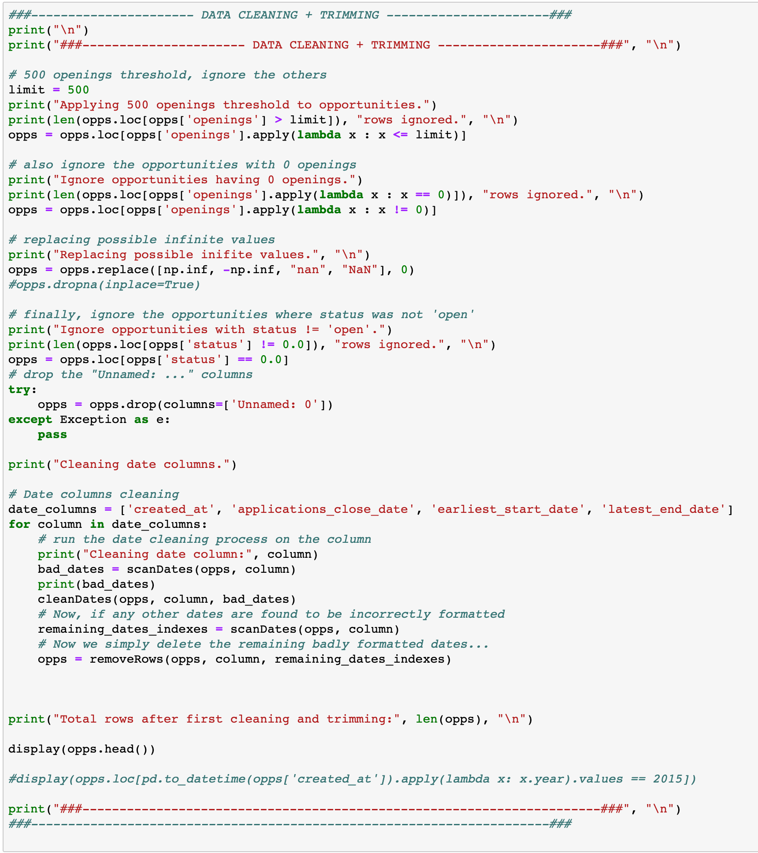
6
Data Cleaning, Filtering, Trimming
Filter only the opportunities with 500 openings or less.
Make sure we have no opportunities with zero openings.
Now, filter only the opportunities which have a status equal to “0.0”, meaning “open”.
When generating the dataframe during the extraction, a “Unnamed: 0” column gets added automatically, we simply remove it.
Specifying which date columns we want to scan and clean (as explained previously).
Iterating over the columns.
Scanning.
Cleaning.
Scanning again. The rows which are recorded here will simply get removed since this means there is no safe way of formatting them.

Slide 37
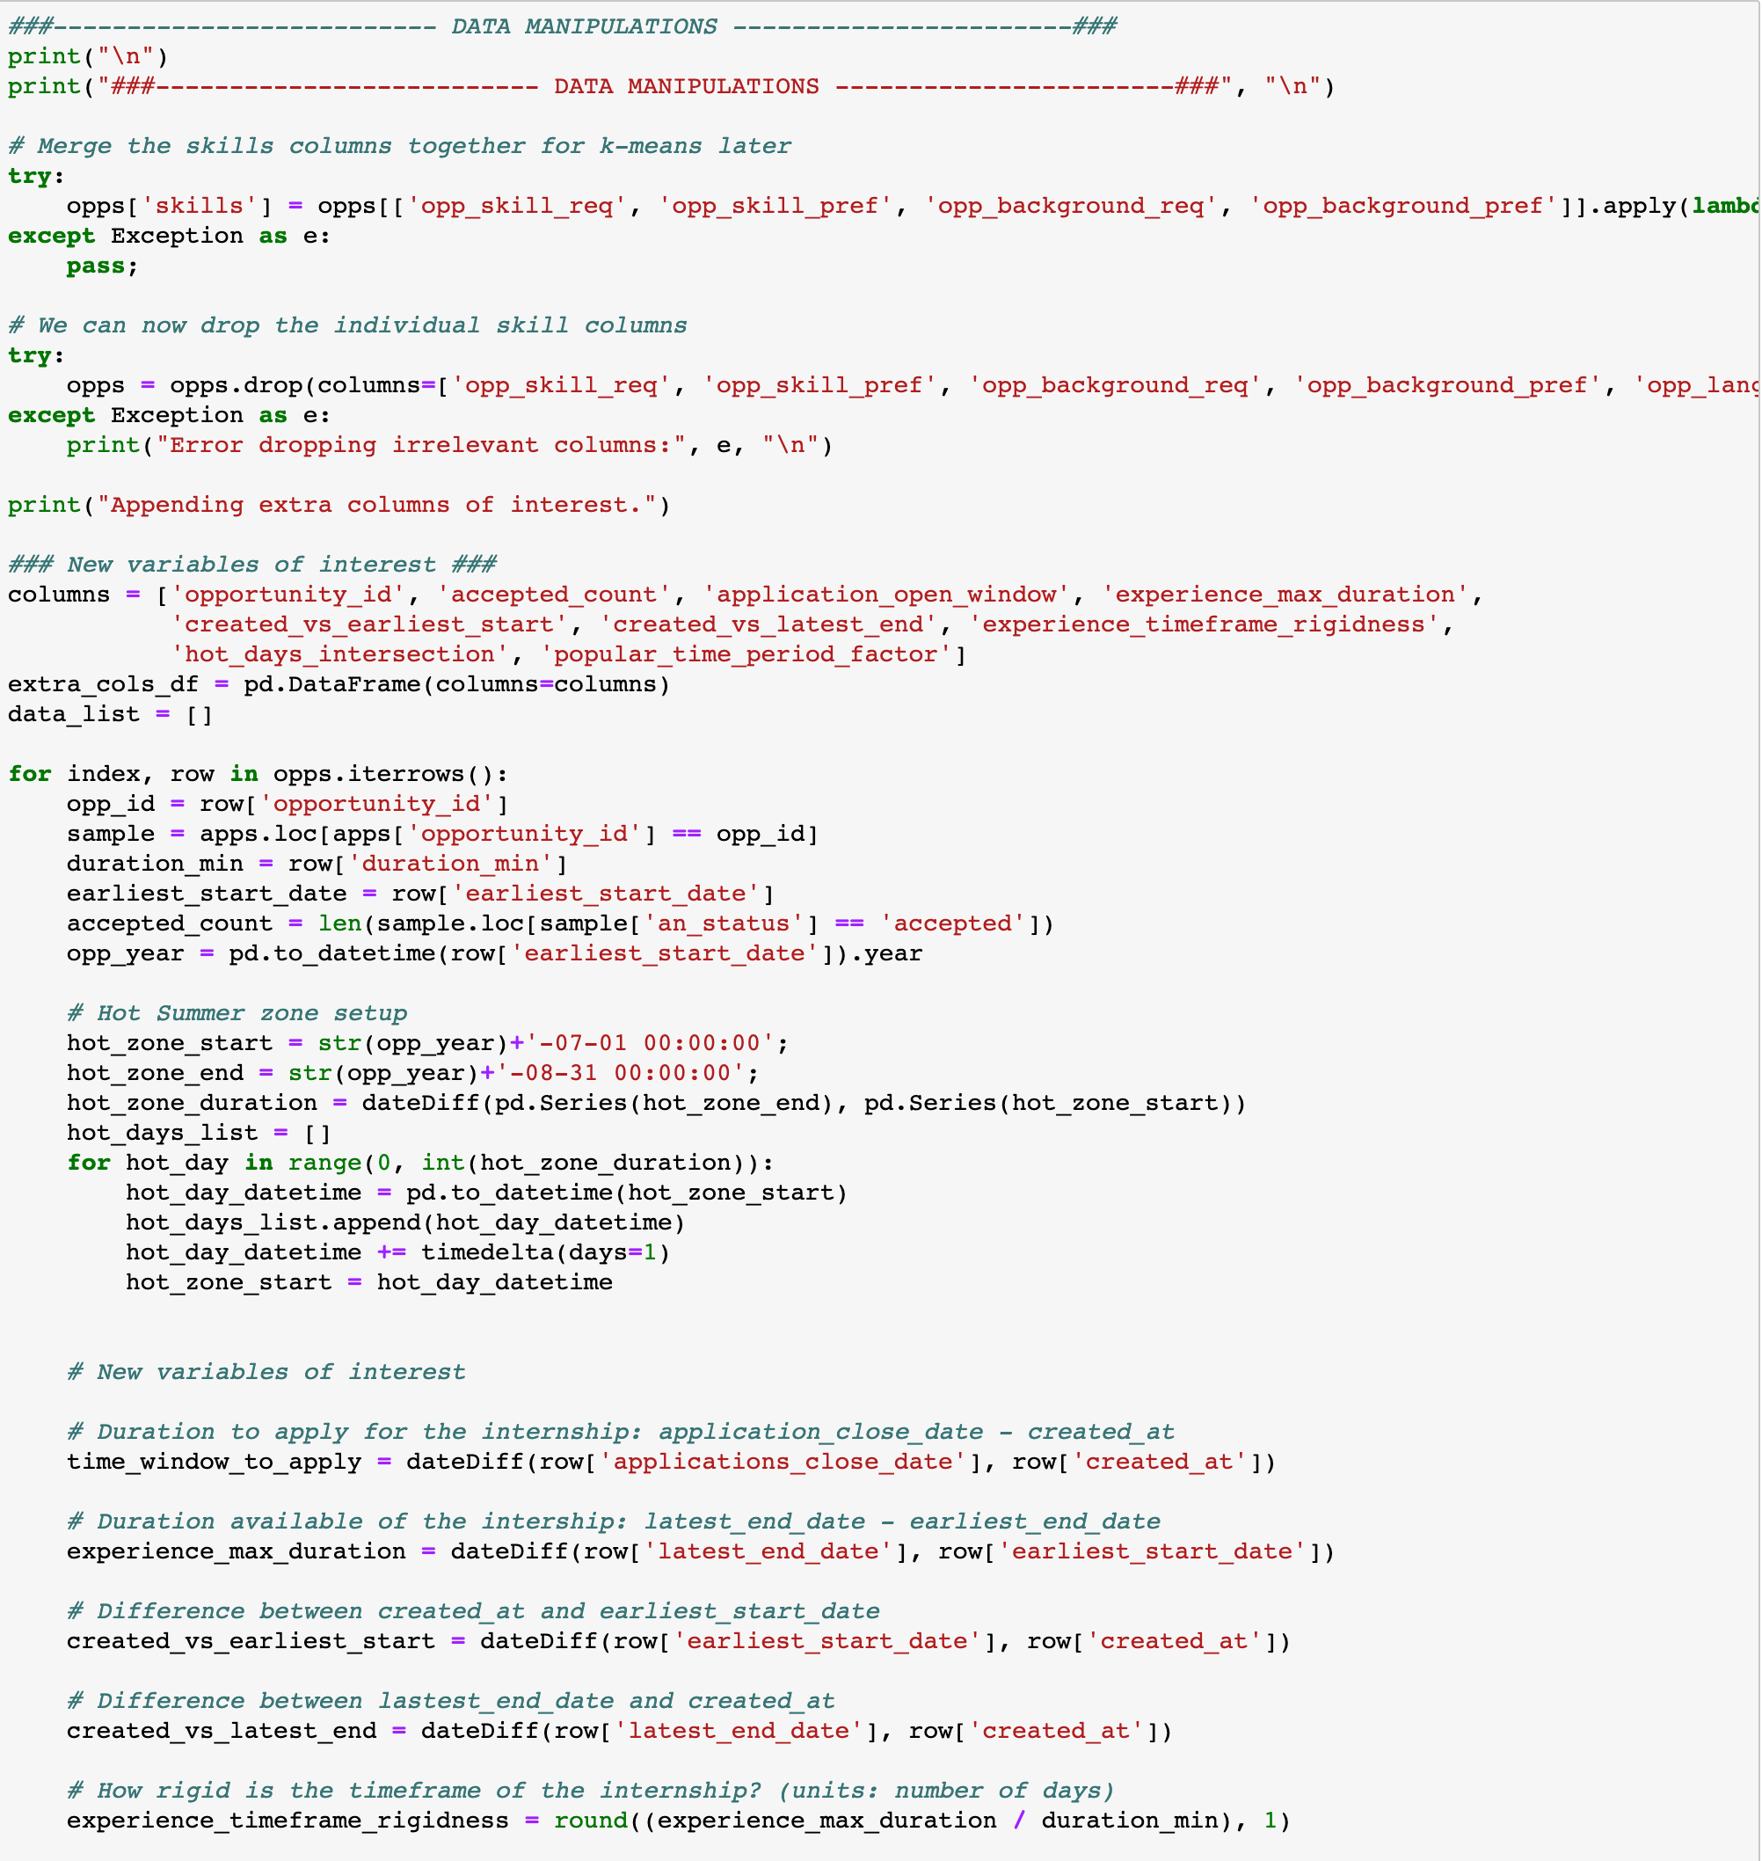
7
Data Manipulations - Extracting Variables of Interest
Merge/Join the specified (list format) columns into one skills column.
Remove the columns after the merge, useless now.
Define the column names of the new variables (part of them).
Iterate over each opportunity row.
The “Hot Summer Zone” block is used to compute the number of days of the opportunity which intersect the months of July and August (popular months for internships).
Computing some date differences. Straightforward.

Slide 38
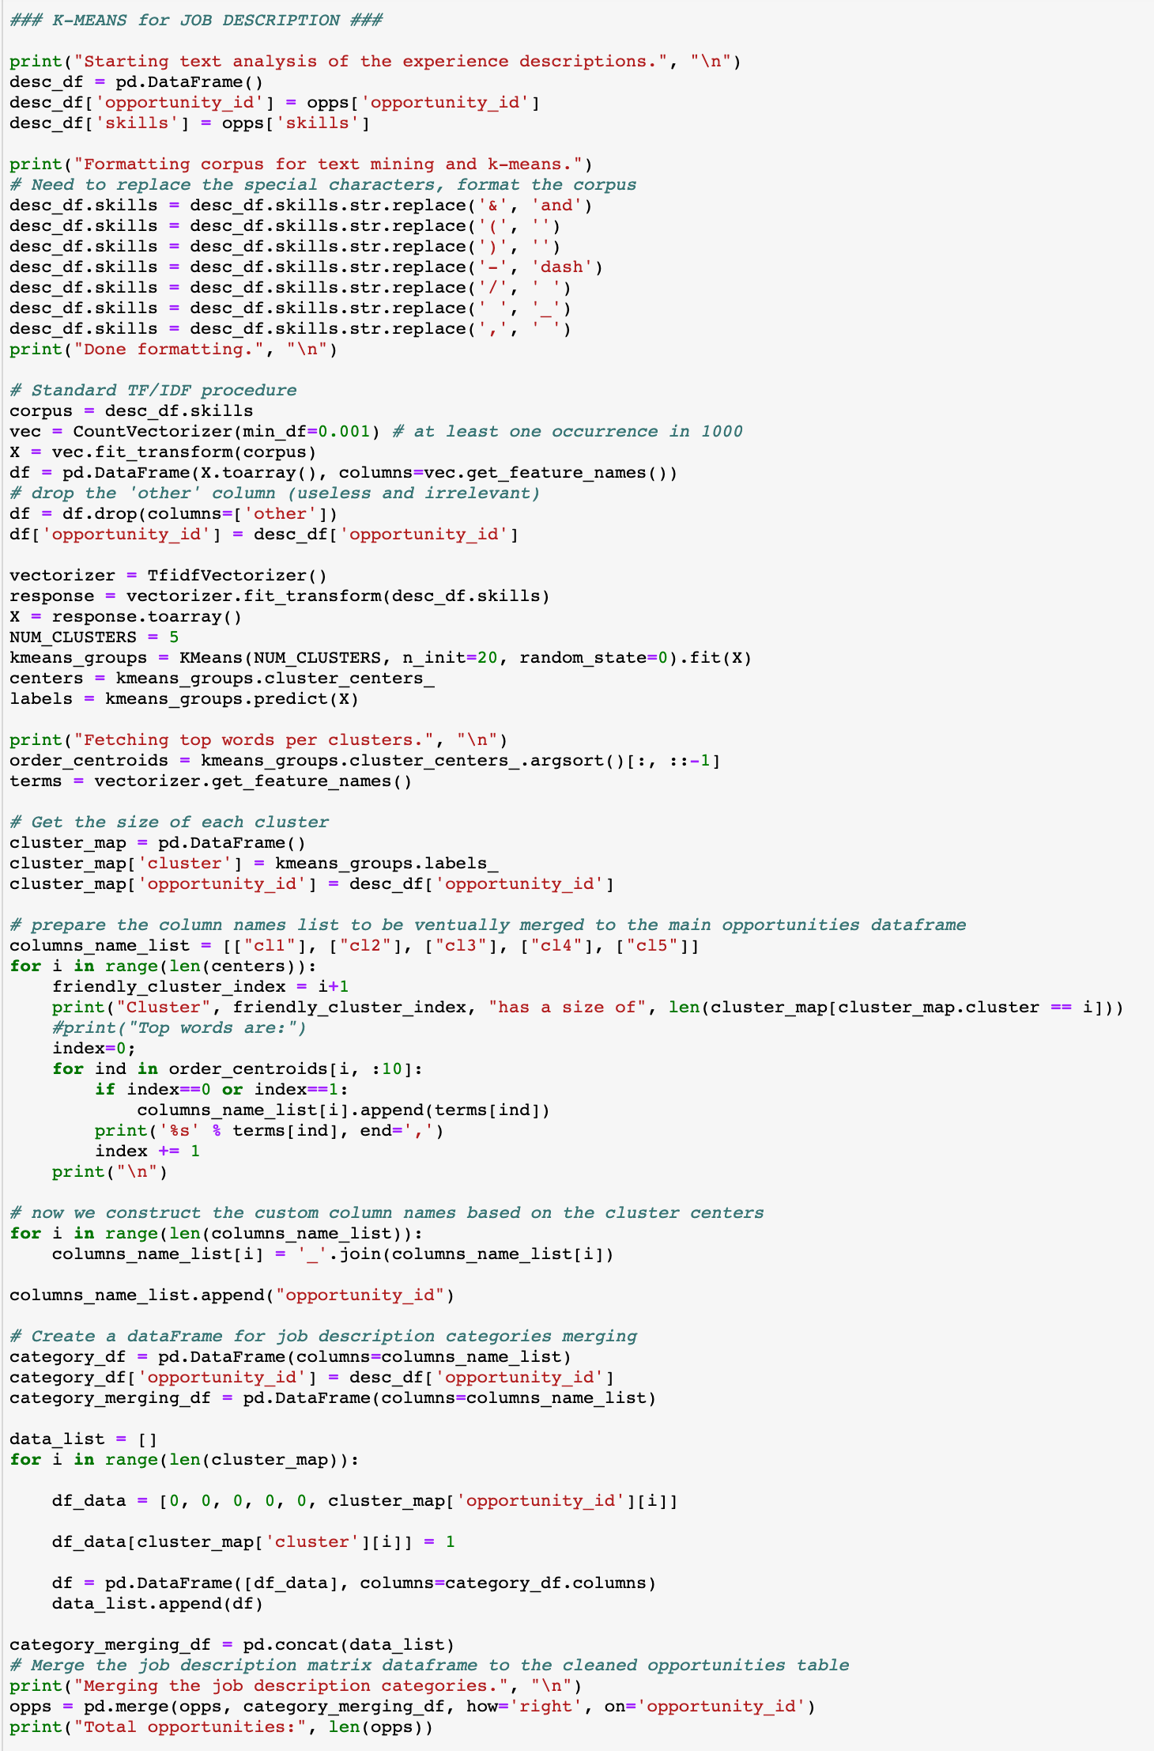
8
Data Manipulations - Text Analysis of Job Description
Create a new dataframe holding the opportunity_id and the skills string.
We format the skills corpus for textual analysis and kmeans clustering of job requirements.
We vectorize the words found the job description, based on their frequency.
We then compute the Term Frequency - Inverse Document Frequency which evaluates the importance of a word in a document.
For more details, visit: https://www.freecodecamp.org/news/how-to-process-textual-data-using-tf-idf-in-python-cd2bbc0a94a3/
Set our number of clusters/centers to 5. Call the sklearn kmeans function and fit it to the corpus.
We sort each center’s words by importance.
Now, we fetch the top words per cluster by iterating over each center, and then iterating over the first 10 words in each cluster.
To create the new columns, we append the first two words for each cluster onto a string either called “cl1”, “cl2”, ”cl3”, etc. referring to “cluster 1”, “cluster 2”, ”cluster 3”, etc. Overall, this generates columns like the following:
Here, we setup a temporary dataframe to be merged to the main opportunities dataframe.
We set the column names as shown above.
Then, we “one-hot encode” the proper column for each opportunity. This categorizes each opportunity by their type of background experiences required.
Finally, we merge the temporary dataframe to the main opportunities dataframe.
Printing out the length of the opportunities dataframe just by curiosity since the length should not have changed. If it has, an error occurred, could be due to duplicated rows or something else.

Slide 39
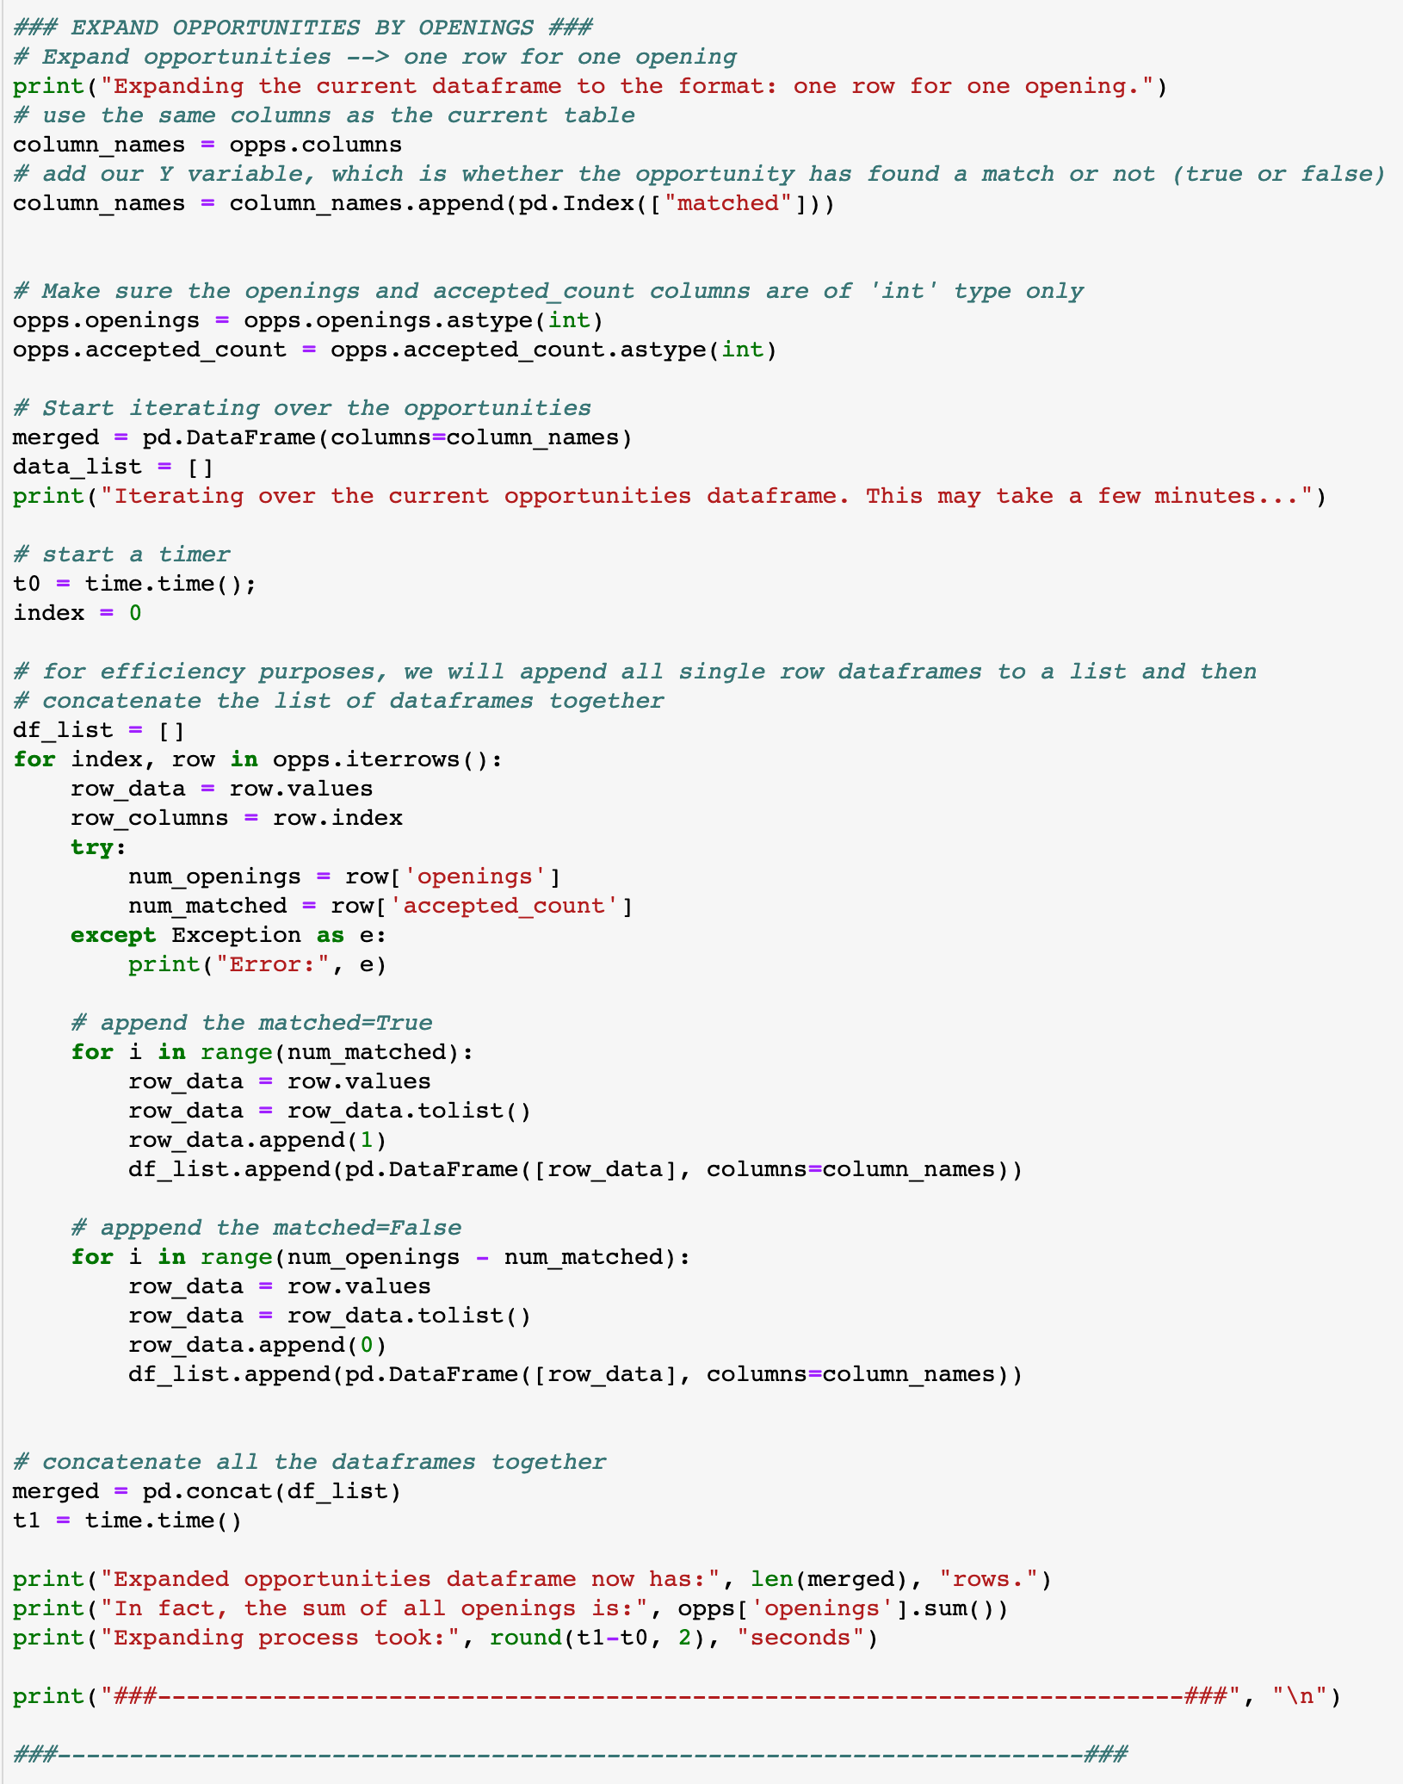
9
Data Manipulations - Expanding by Openings
Adding an extra “matched” column for our target variable (Y).
Create new variable merged which will hold the expanded opportunities dataframe.
We have to iterate over each opportunity.
Record the total openings for this opportunity.
Now, we have to loop a number of times equal to the number of accepted applicants for this opportunity, adding a ”1” in the matched column.
We repeat the same process, iterating (num_openings – num_accepted) times, adding a “0” in the matched column.
Note: The efficiency of the whole iteration described above is average-good. The idea is to create a list and append single line dataframes to it and then use the pd.concat() function to merge all the small dataframes together. For example, it requires around 20 seconds to receive a 5000 line expanded dataframe.

Slide 40
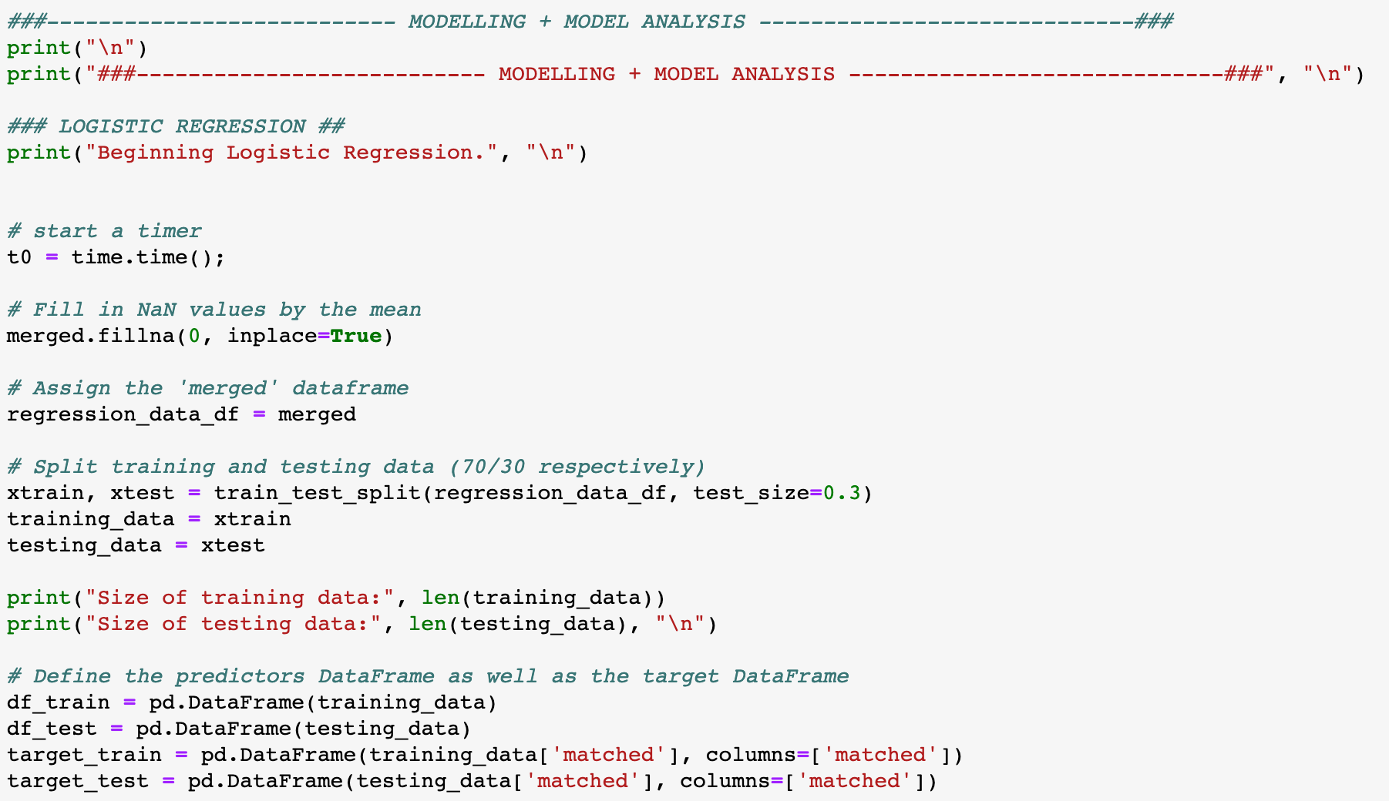
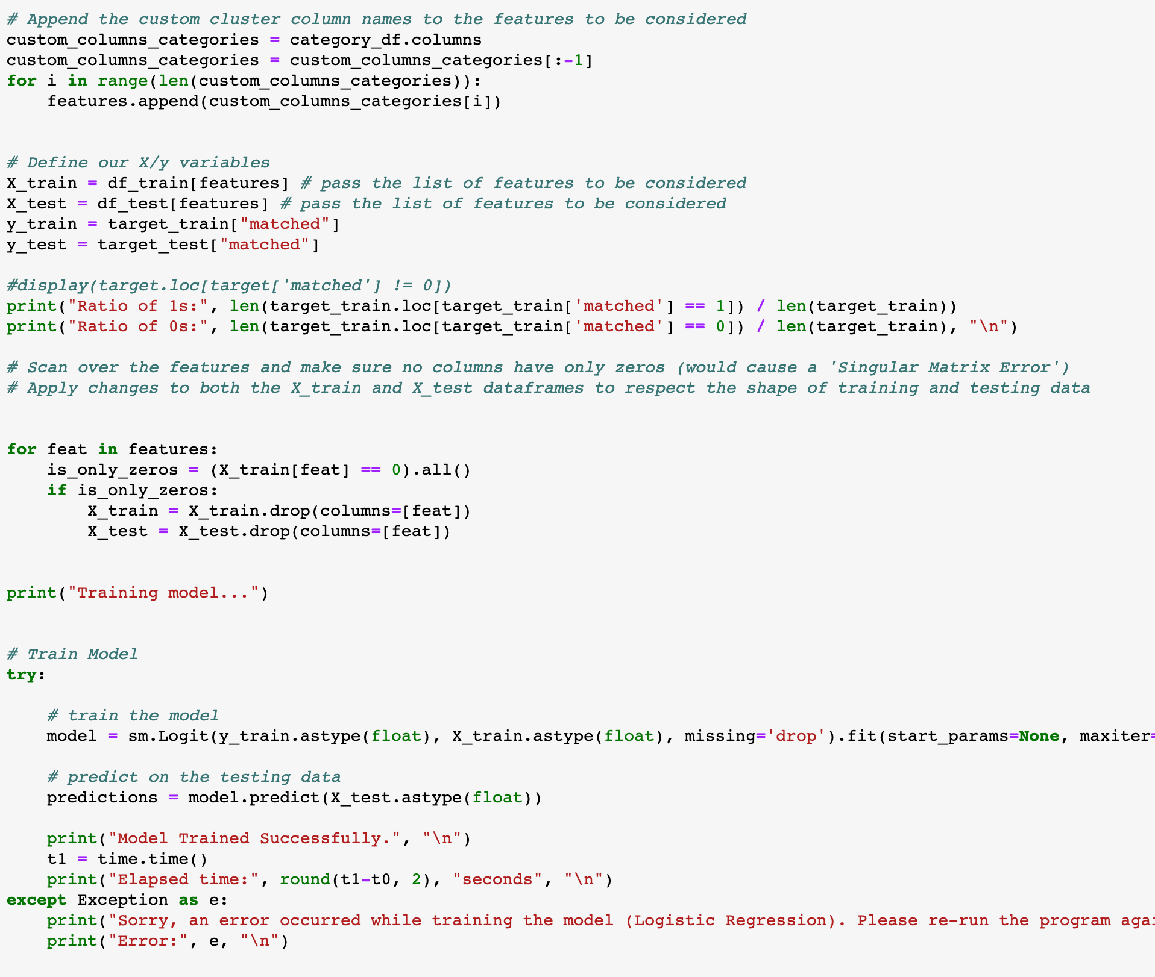
10
Modelling - Logistical Regression
Make sure we have no NaN values in our dataset.
Using the sklearn train_test_split function, we split the training and testing data 70:30 respectively and assign them separate variables.
Dataframe for training data.
Dataframe for testing data.
Here, since the job description cluster columns (as discussed on page 8) are dynamically created, we loop through them and append them to the list of features to be considered by the model.
Set the X variable as all the columns specified by the chosen list of features to consider.
Set the target/Y variable.
Now, we call the statsmodels.Logit() function, passing it the Y and X training variables as floats. For more details on the Logit() and fit() functions, refer to: http://www.statsmodels.org/stable/generated/statsmodels.discrete.discrete_model.Logit.fit.html
We then apply the predict() function to predict the target variable and visualize the classification rate of our model.

Slide 41
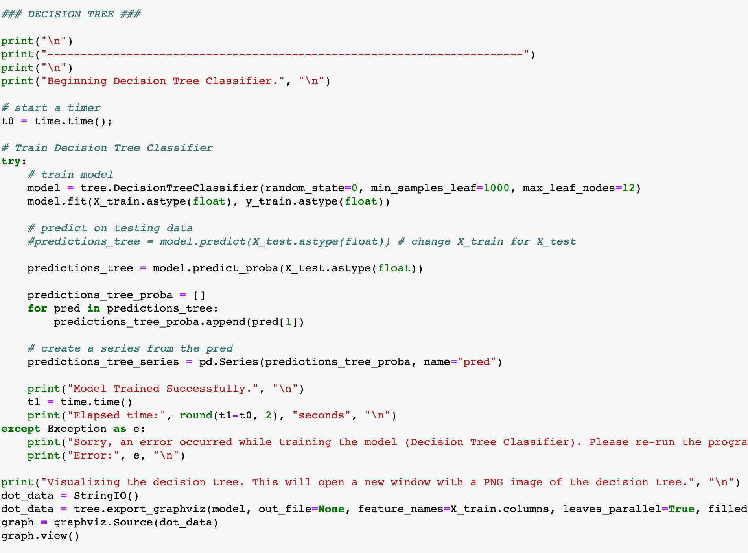
11
Modelling - Decision Tree Classifier
In this section of the code, the same setup variables are used to train the Decision Tree Classifier as the Logistic Regression (i.e.: X_train, X_test, y, df_train, df_test, etc.).
Call the DecisionTreeClassifier() function from the sklearn library.
For more details on the parameters to pass, refer to: https://scikit-learn.org/stable/modules/generated/sklearn.tree.DecisionTreeClassifier.html
Same procedure as described on page 10.
Only difference for the DecisionTreeClassifier is that we must call the .predict_proba() method to get the actual probability values, the .predict() method will return the predicted value only.
For the Decision Tree, we can save a .PDF file of the actual tree generated. The image can be found in the same working directory as “Source.gv.pdf”.

Slide 42
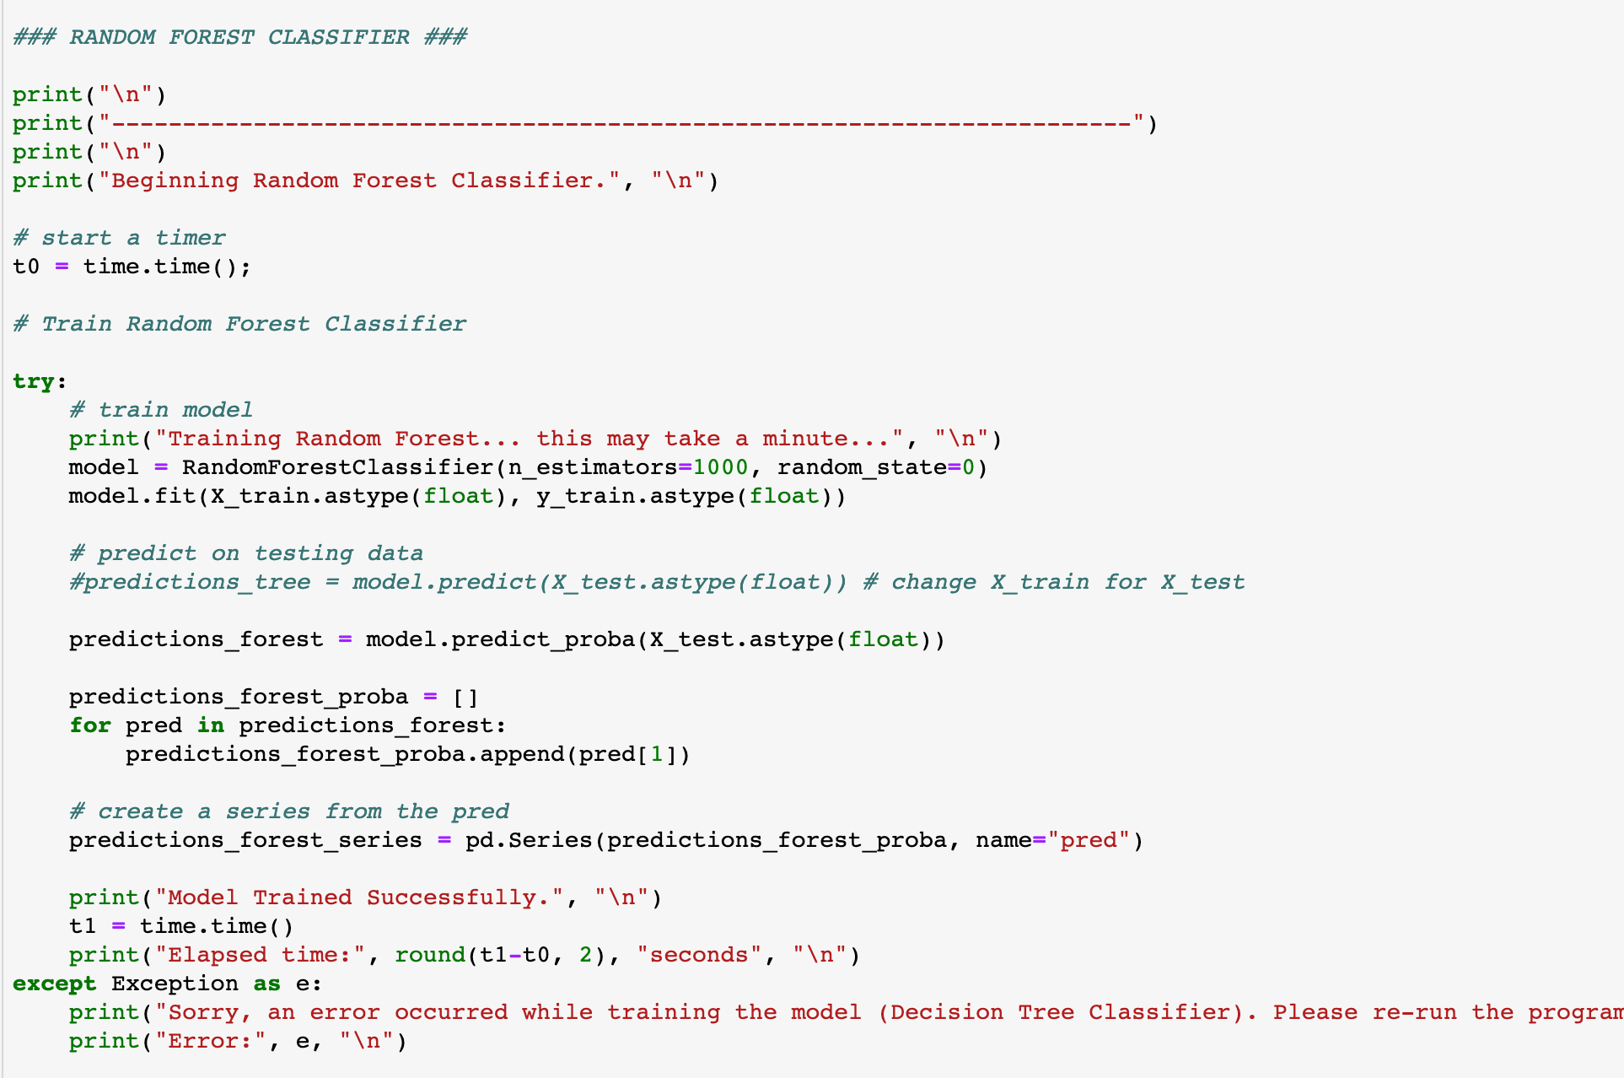
12
Modelling - Random Forest Classifier
In this section of the code, the same setup variables are used to train the Decision Tree Classifier as the Logistic Regression (i.e.: X_train, X_test, y, df_train, df_test, etc.).
Call the RandomForestClassifier() function from the sklearn library with n_estimators=1000.
For more details on the parameters to pass, refer to: https://scikit-learn.org/stable/modules/generated/sklearn.ensemble.RandomForestClassifier.html
Same procedure as described on page 10.
For the random forest classifier, the same procedure to extract the predicted probabilities must be used.

Slide 43
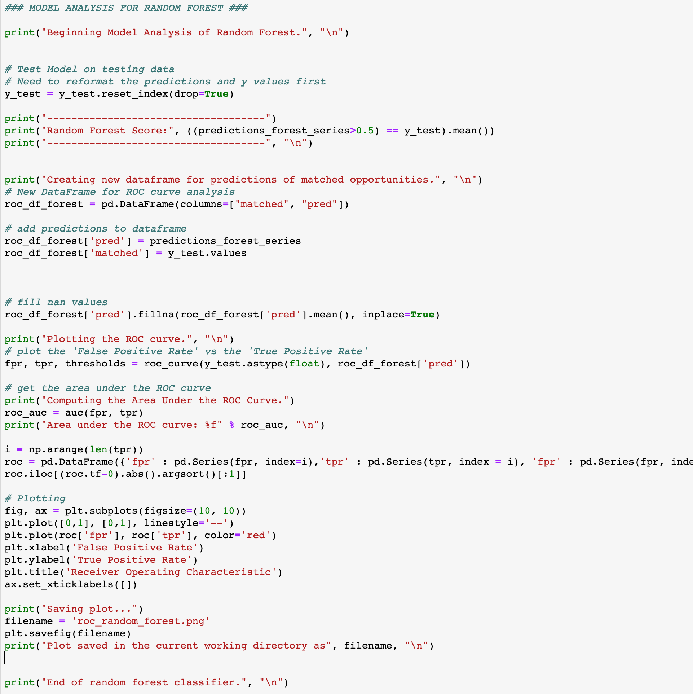
13
Analysis - Classification Rates, ROC curves
To analyze the accuracy of our models, we use a ROC curve.
For more details, visit: https://en.wikipedia.org/wiki/Receiver_operating_characteristic
We generate the predictions of our target variable using our testing data.
The model’s classification score is computed by getting the average of the probability which are greater than our cutoff (here, 0.5) In both the predicted true value for a given row.
Create a dataframe with a matched and pred (as in ”prediction”) and set their values. This will be used to plot the ROC curve.
We plot the True Positive Rate (TPR) vs the False Positive Rate (FPR).
Using the sklearn auc() function, we compute the area under the ROC curve, which is a measure of the model’s reliability. Closer to 1 meaning very accurate (although could also signify overfit).
Using the matplotlib.pyplot library, we illustrate the curves.
We save the ROC curve as a .PNG file in the same working directory as the matcha.py file.
Note: almost exact same code is used to analyze the Logistic Regression and Decision Tree.

Slide 44
End of Appendix

